Slide 1
Microprocessor System Design
Input / Output
Peripheral Interfacing
Prof. Virender Kr. Ranga
Department of Computer Engg.
National Institute of Technology
Kurukshetra
Prof. Virender Kumar Ranga@2009

Slide 2
Outline
Peripheral devices
  Input devices
  Output devices
8 bit / 16-bit IO
Simple Input device - interfacing switches
Simple Output device - interfacing LEDs
8255 PPI
8255 modes
Prof. Virender Kumar Ranga@2009

Slide 3
Peripheral
is an input and/or output device
like a memory chip, it is mapped to a certain location (called the port address)
unlike a memory chip, a peripheral is usually mapped to a single location
Prof. Virender Kumar Ranga@2009

Slide 4
Output Device
like a memory chip, you can write to an output device
You can write to a memory chip using the command mov [bx], al
You can write to an output device using the command out dx, al
Prof. Virender Kumar Ranga@2009

Slide 5
Input Device
like a memory chip, you can read from an input device
You can read from a memory chip using the command mov al, [bx]
You can read from an input device using the command in al, dx
Prof. Virender Kumar Ranga@2009

Slide 6
Two formats for IN / OUT
Format 1
IN AL, port#
Or
OUT port#, AL
Example:
  BACK: IN AL,22H
  CMP AL, 100
  JNZ BACK
Format 2
MOV DX,port#
IN AL, DX
Or
MOV DX, port#
OUT DX, AL
Prof. Virender Kumar Ranga@2009

Slide 7
8bit vs 16bit IO
8086 case:
MOV DX, 648H
OUT DX, AX ;AX = 76A9H
Address bus and ALE
Word (76A9), IOW
Prof. Virender Kumar Ranga@2009

Slide 8
Creating a Simple
Output Device
Use 8-LED’s
Prof. Virender Kumar Ranga@2009

Slide 9
Use 8 LED’s
A19
A18
:
A0
:
mov al, 55
out dx, al
:
:
:
D7
D6
D5
D4
D3
8086
D2
D1
Minimum
D0
Mode
IOR
IOW
Prof. Virender Kumar Ranga@2009

Slide 10
Creating a Simple
Output Device
Use 8-LED’s
Use a chip and an address decoder such that the LED’s will respond only to the command out and a specific address (let’s assume that the address is F000)
Prof. Virender Kumar Ranga@2009

Slide 11
Use of 74LS245 and Address Decoder
A19
A18
:
A0
D7
A0
B0
D6
A1
B1
D5
A2
B2
D4
A3
B3
D3
A4
74LS245
B4
8086
D2
A5
B5
D1
A6
B6
Minimum
D0
A7
B7
Mode
E
DIR
5V
IOR
:
mov al, 55
mov dx, F000
out dx, al
:
IOW
A
A
A
A
A
A
A
A
A
A
A
A
A
A
A
A
IOW
1
1
1
1
1
1
9
8
7
6
5
4
3
2
1
0
5
4
3
2
1
0
Prof. Virender Kumar Ranga@2009

Slide 12
Creating a Simple
Output Device
Use 8-LED’s
Loses the data
Solution?
Use a chip and an address decoder such that the LED’s will not only respond to the command out and a specific address (let’s assume that the address is F000) but will also latch the data
Prof. Virender Kumar Ranga@2009

Slide 13
Use of 74LS373 and Address Decoder
A19
A18
:
A0
D7
D0
Q0
D6
D1
Q1
D5
D2
Q2
D4
D3
Q3
D3
D4
74LS373
Q4
8086
D2
D5
Q5
D1
D6
Q6
Minimum
D0
D7
Q7
Mode
LE
OE
IOR
IOW
:
mov al, 55
mov dx, F000
out dx, al
:
A
A
A
A
A
A
A
A
A
A
A
A
A
A
A
A
IOW
1
1
1
1
1
1
9
8
7
6
5
4
3
2
1
0
5
4
3
2
1
0
Prof. Virender Kumar Ranga@2009

Slide 14
Creating a Simple
Input Device
Use 8-Switches (keys)
Use a chip and an address decoder such that the keys will be read only to the command in and a specific address (let’s assume that the address is F000)
How to interface a switch to computer?
Prof. Virender Kumar Ranga@2009

Slide 15
Use of 74LS245 and Address Decoder
A19
5V
A18
:
A0
D7
A0
B0
D6
A1
B1
D5
A2
B2
D4
A3
B3
D3
A4
74LS245
B4
8088
D2
A5
B5
D1
A6
B6
Minimum
D0
A7
B7
Mode
E
DIR
IOR
:
mov dx, F000
in al, dx
:
IOW
A
A
A
A
A
A
A
A
A
A
A
A
A
A
A
A
IOR
1
1
1
1
1
1
9
8
7
6
5
4
3
2
1
0
5
4
3
2
1
0
Prof. Virender Kumar Ranga@2009
Same address for input and output?

Slide 16
How the microprocessor know that if a user has pressed a button?
By Polling
By Interrupt
Prof. Virender Kumar Ranga@2009

Slide 17
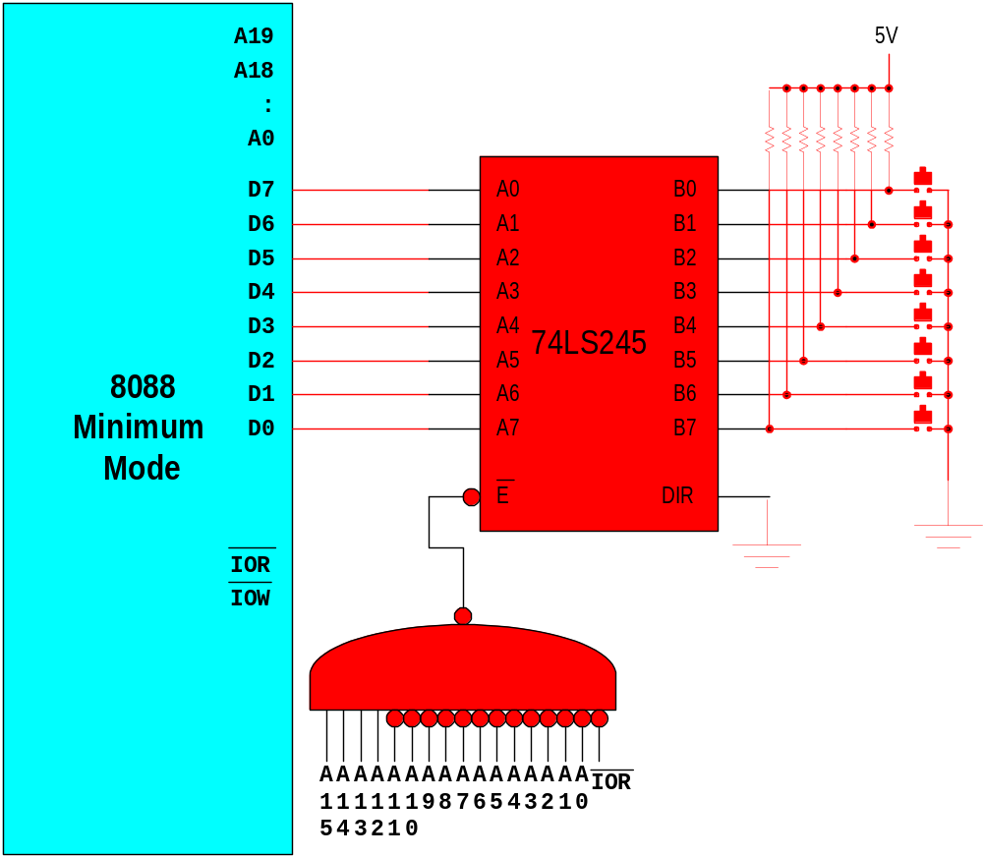
Polling
mov dx, F000
in al, dx
L1: cmp al, FF
je L1
:
:
Prof. Virender Kumar Ranga@2009

Slide 18
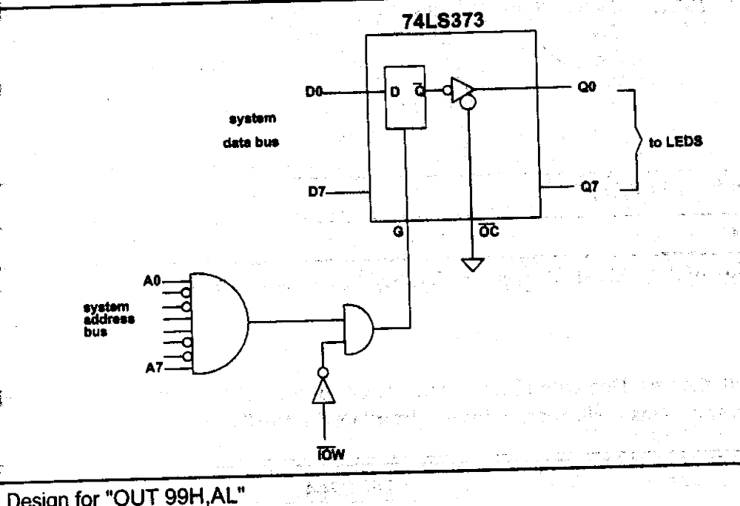
Output Port Design
T1 – T4 of OUT 99H, AL ?
Prof. Virender Kumar Ranga@2009

Slide 19
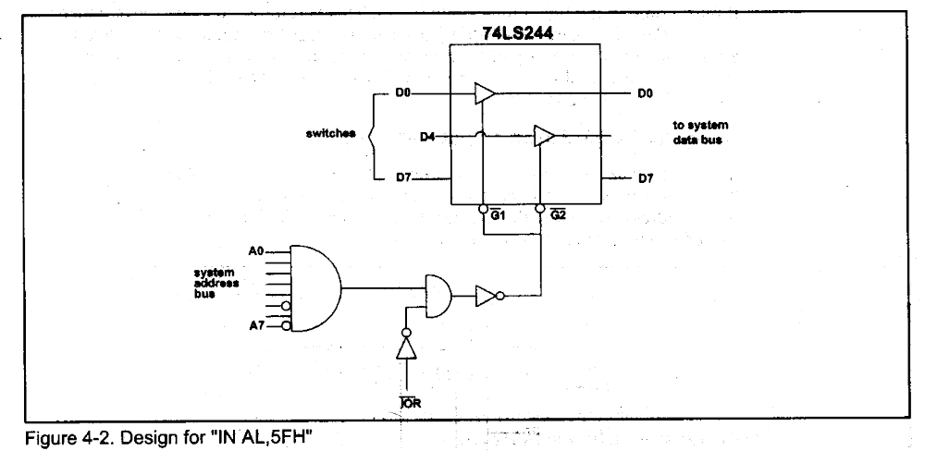
Input Port Design
T1 – T4 of IN AL, 5FH ?
Prof. Virender Kumar Ranga@2009

Slide 20
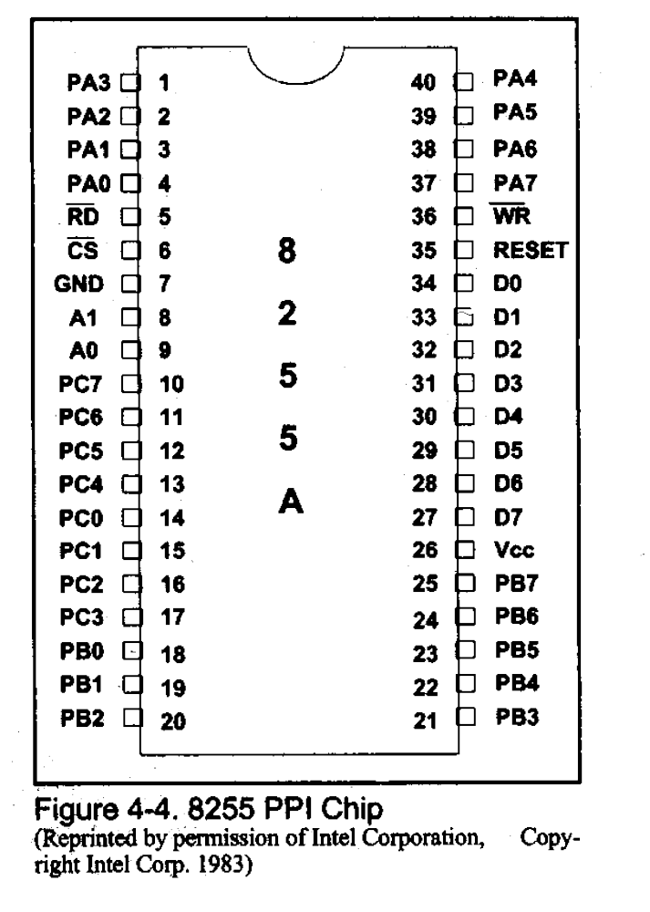
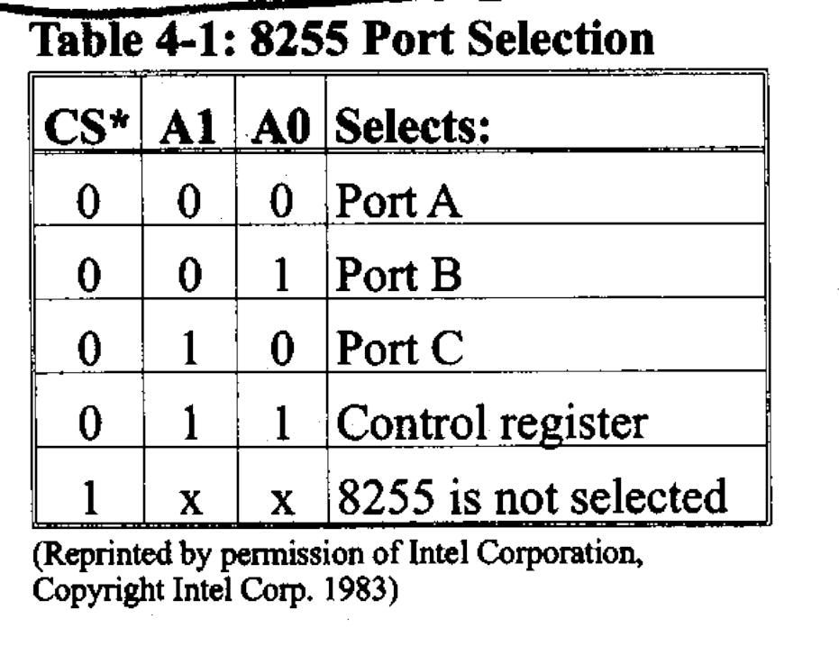
8255 PPI
Prof. Virender Kumar Ranga@2009

Slide 21
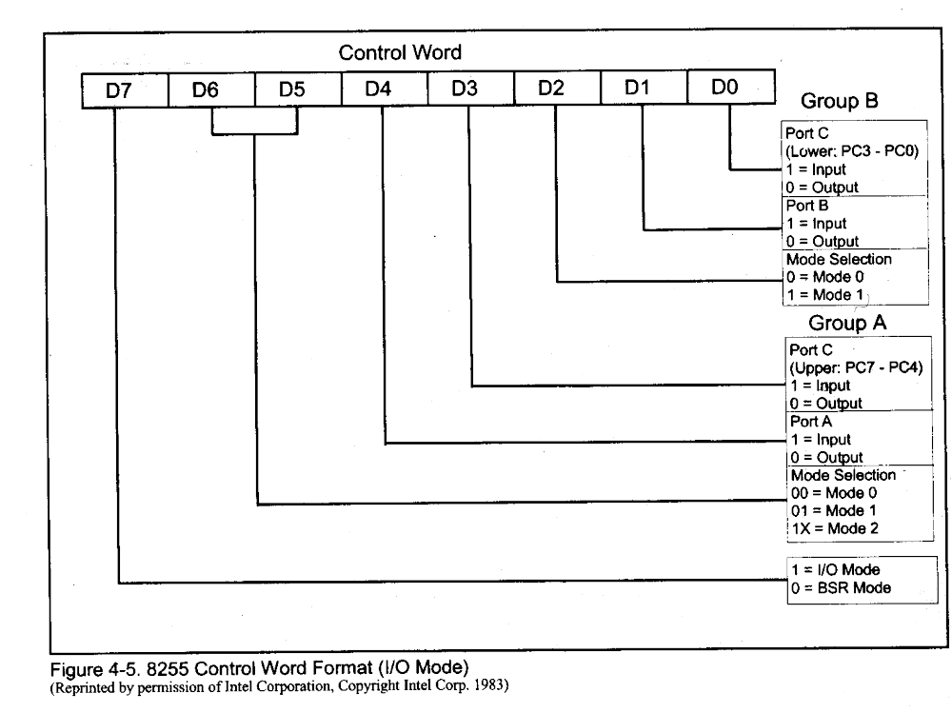
Control word
Prof. Virender Kumar Ranga@2009

Slide 22
Modes of Operation
Mode 0 – simple input or output
Mode 1 – input or output with handshaking
Mode 2 – bidirectional IO with handshaking
Prof. Virender Kumar Ranga@2009

Slide 23
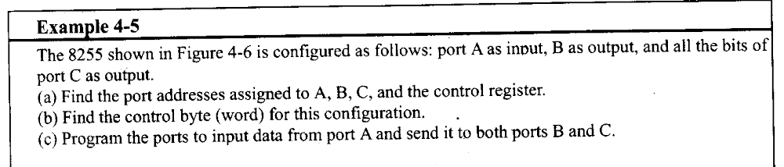
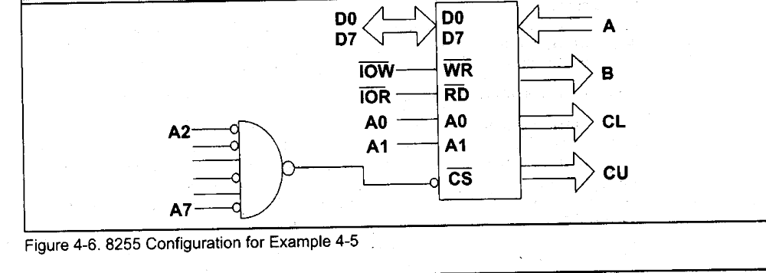
Example - Port addresses
Prof. Virender Kumar Ranga@2009

Slide 24
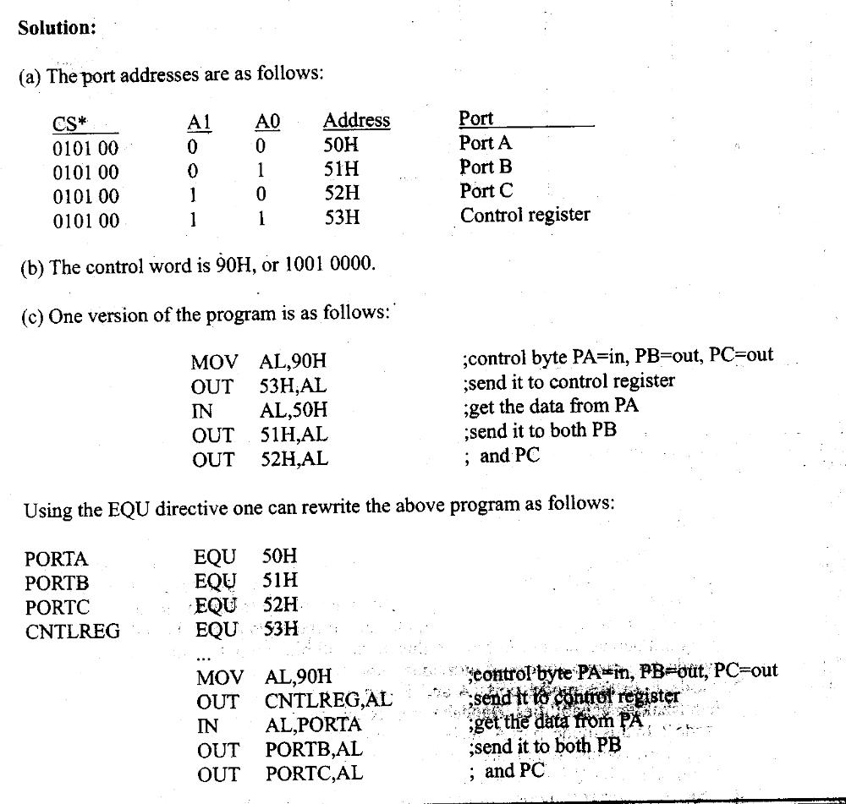
Solution
Prof. Virender Kumar Ranga@2009

Slide 25
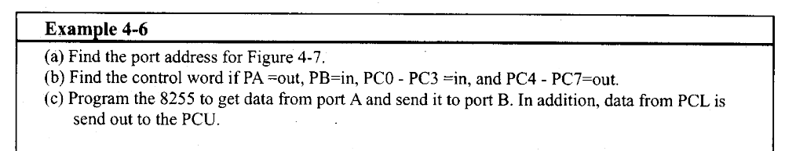
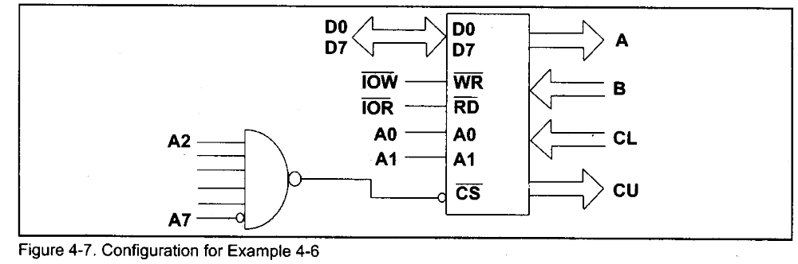
Example – Programming 8255
Prof. Virender Kumar Ranga@2009

Slide 26
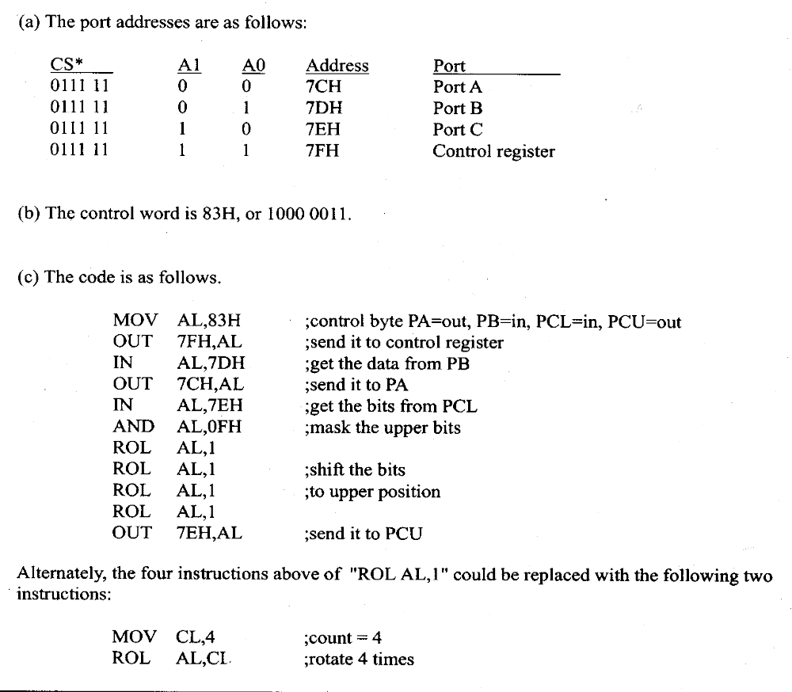
Solution
Prof. Virender Kumar Ranga@2009

Slide 27
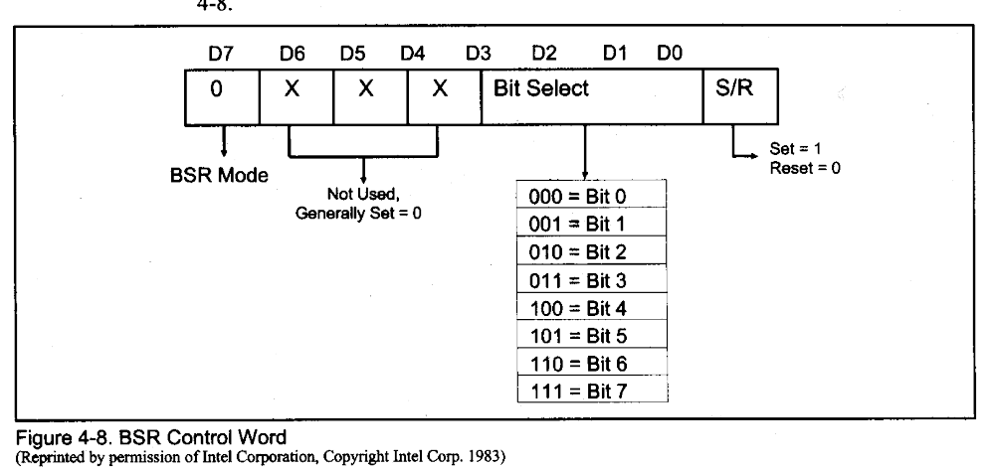
BSR mode
Prof. Virender Kumar Ranga@2009

Slide 28
Example for BSR
Program 8255 for the following
  A) set PC2 to high
  B) Use PC6 to generate a square wave of 66% duty cycle
Solution
A)
  MOV AL, 00000101B
  OUT 93H,AL
B)
  MOV AL, 0xxx1101
  OUT 93H, AL
  CALL Delay
  CALL Delay
  MOV AL, 0xxx1100
  OUT 93H, AL
  CALL Delay
  JMP AGAIN
Prof. Virender Kumar Ranga@2009

Slide 29
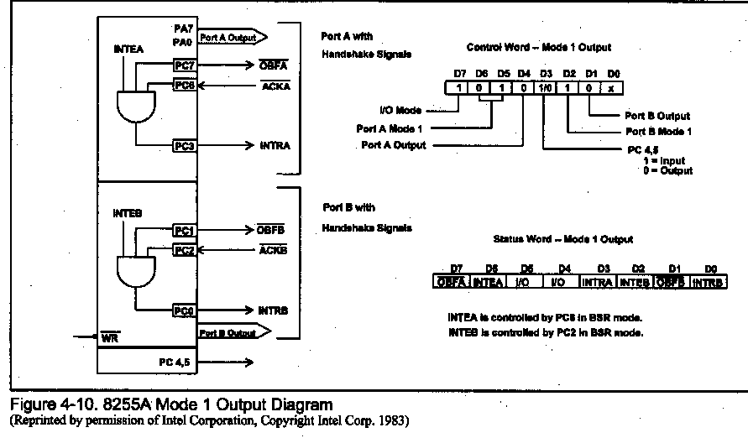
MODE 1 Output Operation
Prof. Virender Kumar Ranga@2009
Notes:
Status word is read from port c
Intea and inteb are written using PC6 and PC2

Slide 30
Output with handshake
OBFa :
  CPU has written a byte
ACKa:
  Data has been picked up by receiving device
INTRa:
  After rising edge of #ACKa
INTEa (interrupt enable)
  Internal flipflop
  Controlled by PC6
Prof. Virender Kumar Ranga@2009

Slide 31
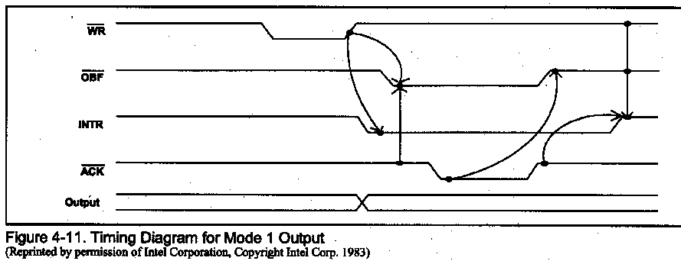
MODE 1 Timing (output)
Prof. Virender Kumar Ranga@2009

Slide 32
Interrupt vs. Polling
CPU is interrupted whenever necessary
CPU can serve many devices
Require more hardware
Prof. Virender Kumar Ranga@2009

Slide 33
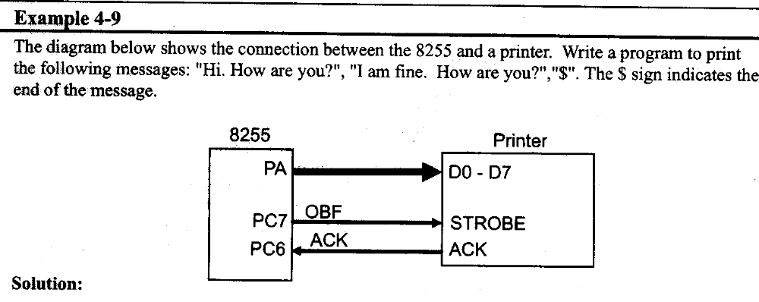
Using status to Poll
Prof. Virender Kumar Ranga@2009

Slide 34
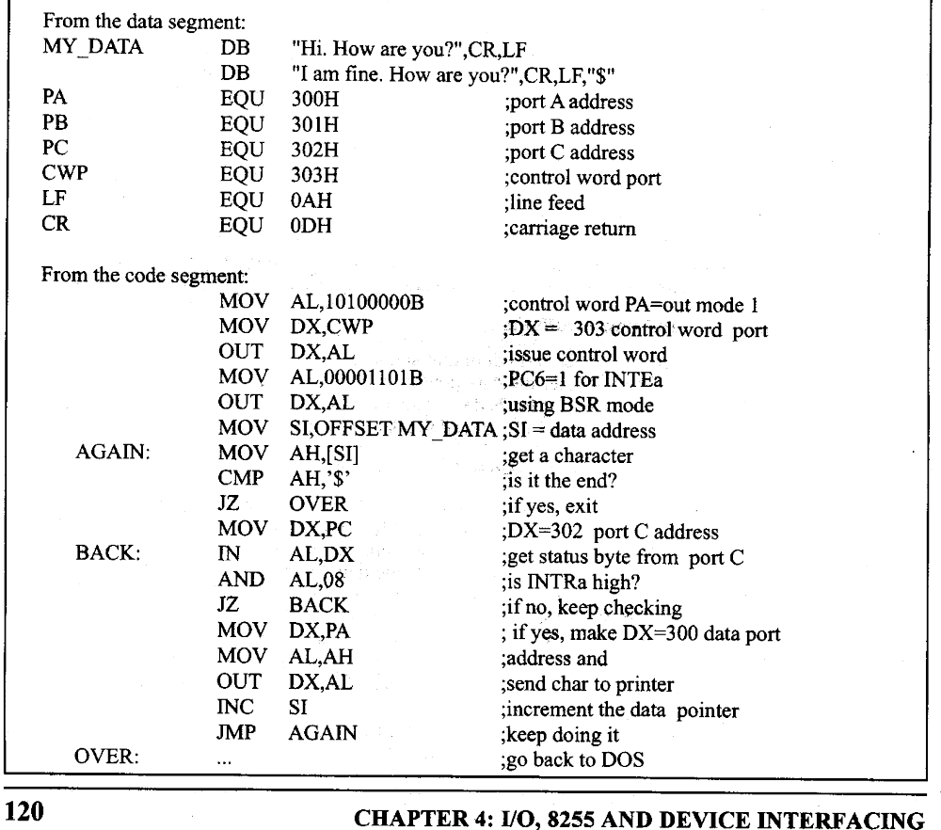
Solution
Prof. Virender Kumar Ranga@2009

Slide 35
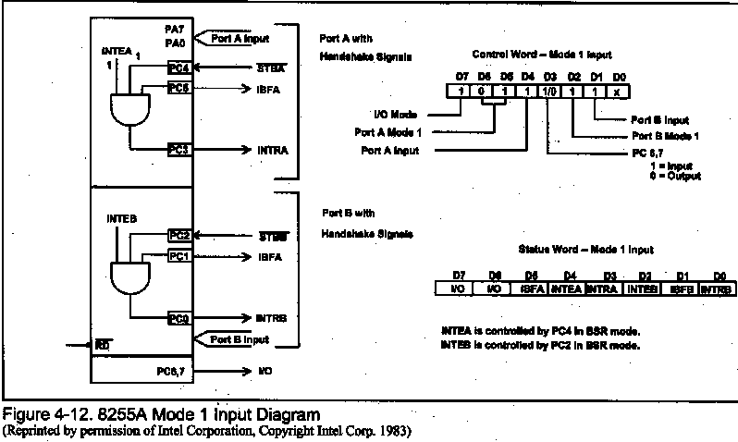
MODE 1 Input Operation
Prof. Virender Kumar Ranga@2009

Slide 36
Input with handshake
STB (in):
  Device provides data to an input port
IBF (out):
  Data has been latched by 8255
INTR (out):
  After activation of IBF
INTE (interrupt enable)
  Internal flip-flop
  Controlled by PC4 and PC2
Prof. Virender Kumar Ranga@2009

Slide 37
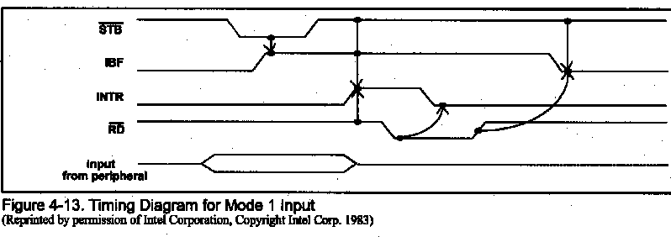
MODE 1 Timing (input)
Prof. Virender Kumar Ranga@2009

Slide 38
Mode 2
The salient features of this mode are:
The signal 8-bit port in group A is available.
The 8-bit port is bidirectional and additionally a 5-bit control port is available.
Three I/O lines are available at port C Viz. PC2-PC0
Prof. Virender Kumar Ranga@2009

Slide 39
Mode 2
Inputs and outputs are latched.
The 5-bit control port C( PC3-PC7) is used for generating/accepting handshaking signals for the port 8-bit data transfer on port A.
Prof. Virender Kumar Ranga@2009

Slide 40
Control signals for output operations in Mode 2
OBF :Active low
  CPU has written data to Port A
ACK: Active low
  Data has been picked up by receiving device
INTR: Active high
  After rising edge of ACKa
INTEa (interrupt enable)
  Internal flipflop
  Controlled by PC6
Prof. Virender Kumar Ranga@2009

Slide 41
Control signals for input operations in Mode 2
STB :
  Device provides data to an input port A
IBF:
  Data has been latched by 8255
INTR:
  After activation of IBF
INTE (interrupt enable)
  Internal flip-flop
  Controlled by PC4 and PC2
Prof. Virender Kumar Ranga@2009

Slide 42
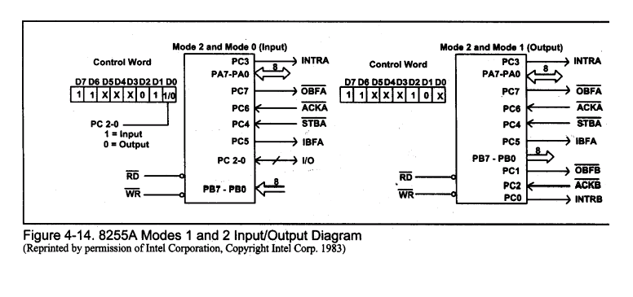
MODE 2 Operation
Prof. Virender Kumar Ranga@2009

Slide 43
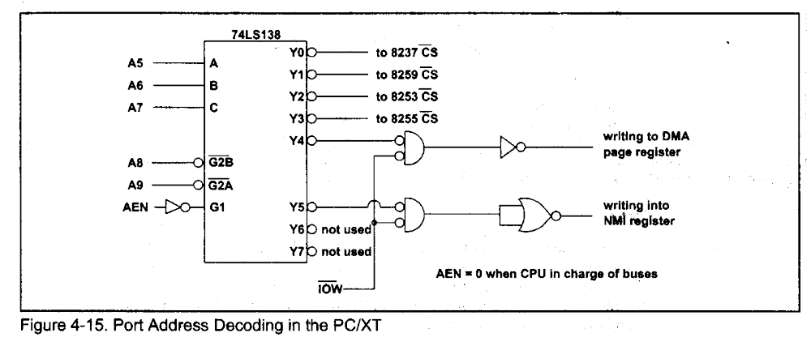
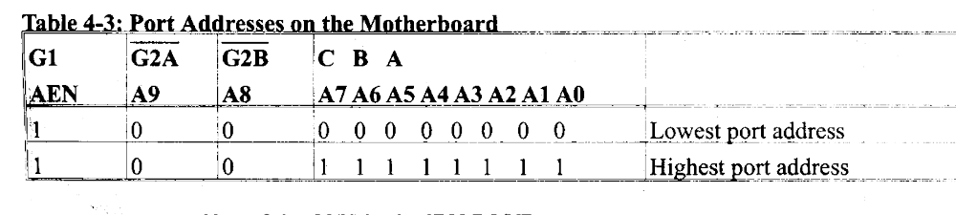
Decoding by 74138
Prof. Virender Kumar Ranga@2009

Slide 44
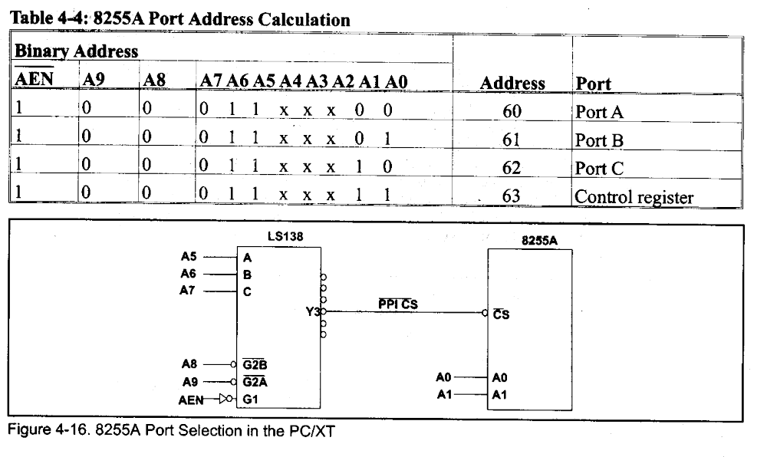
8255 Address in PC
Prof. Virender Kumar Ranga@2009

Slide 45
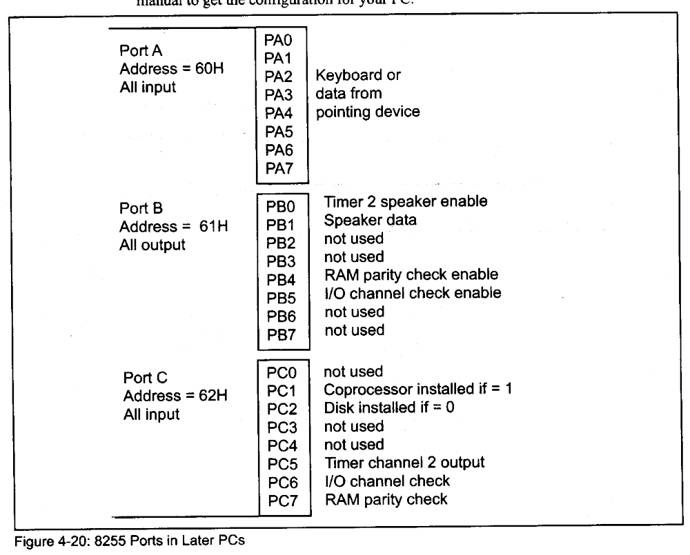
Use of 8255 ports in PC
MOV AL,99H
OUT 63, AL
Prof. Virender Kumar Ranga@2009
Notes:
In earlier PC port A was used to read from DIP switches

Slide 46
80x86 family
16-bit Processors
  8088 (8-bit data / 20-bit address)
  8086/186 (16-bit data / 20-bit address)
  80286 (16-bit data / 24-bit address)
32-bit Processors
  80386 (16/24 or 32/32 common)
  80486 (32/32), Pentium, PII (64/32)
  Pentium Pro, II, III, IV (64/36)
  PPC 60x (32 or 64/32)
All 80x86 processors use a 16-bit address for i/o
Prof. Virender Kumar Ranga@2009
Notes:
We have to go to 16-bit micro to explain later about IO interfacing in them.

Slide 47
8 And 16 bit Organizations
8088
  Data is organized into byte widths
  The 1MB memory is organized as 1M x 8-bits
8086/80186
  Data is organized into word widths
  The 1MB memory is organized as 512kB x 16-bits
80286/80386SX
  Data is organized into word widths
  The 16MB memory is organized as 8MB x 16-bits
Prof. Virender Kumar Ranga@2009

Slide 48
32 and 64 bit Organizations
• 80386DX/80486
  – Data is organized into double word widths
  – The 4GB memory is organized as 1GB x 32-bits
• Pentium Pro/Pentium 1-4
  – Data is organized into quad word widths
  – The 4GB memory is organized as 512MB x64-bits
(on P2-4, actual address bus is 36 bits)
Prof. Virender Kumar Ranga@2009

Slide 49
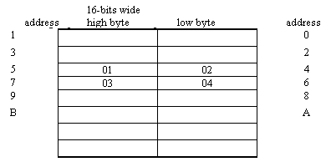
Memory Alignment in 16-bit Micro
We have 16-bit data bus
Why not use it for memory access.
1M byte of memory is organized as:
512K * 16 bit
The memory is word-aligned
Access to even addresses is aligned and simple
Example: 0102H and 0304H stored in [4H]
What happens on mov AX,[4]?
What happens on mov AX,[5]?
Motorola family of the MC680x0 forbids non-aligned access
Prof. Virender Kumar Ranga@2009
Notes:
The answer for mov AX,[5] depends:
If the processor allows non-aligned access.
How to interface memory

Slide 50
Memory Bank Select
8086/186/286/386SX has 16 Data Lines D15-D0
6264 Only has 8 I/O7 – I/O0
Must Use a “Memory Bank”
  1 SRAM for Storing Bytes with “Even Addresses” (… 0 2 )
  1 SRAM for Storing Bytes with “Odd” Addresses” (… 1 3 )
8086 has BHE Control Signal – (Bank High Enable)
Can Use Combination of A0 and BHE to Determine Type of Access
  BHE A0 Access Type
  0 0 1 word (16-bits)
  0 1 Odd Byte (D15-D8)
  1 0 Even Byte (D7-D0)
  1 1 No Access
Prof. Virender Kumar Ranga@2009

Slide 51
Interfacing two 512KB Memory to the 8086 Microprocessor
AX
3F1C
A0
7FFFF
36
BX
0023
A19
A18
7FFFE
25
CX
0000
:
:
7FFFD
19
DX
FCA1
A1
A0
:
:
D7
D7
20023
13
CS
XXXX
:
:
20022
7D
SS
XXXX
D0
D0
20021
12
DS
4000
20020
1C
29
ES
XXXX
MEMR
RD
:
:
MEMW
WR
00001
95
BP
XXXX
CS
00000
23
SP
XXXX
SI
XXXX
7FFFF
12
DI
XXXX
A18
7FFFE
98
:
7FFFD
2C
IP
XXXX
A0
:
:
D15
D7
20023
33
:
:
20022
45
MOV [0040], AL?
MOV [0041], AH?
MOV [0040], AX?
D8
D0
20021
92
20020
3F
A3
RD
:
:
WR
00001
D4
BHE#
CS
00000
97
Prof. Virender Kumar Ranga@2009

Slide 52
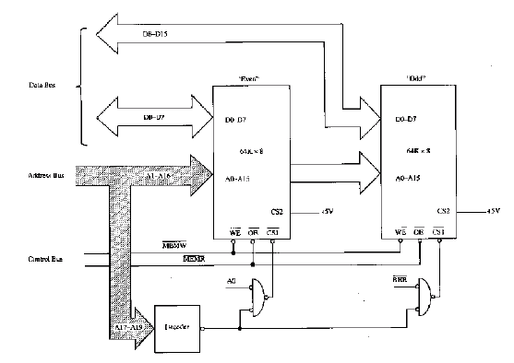
Decoding Circuit with Bank Select
Prof. Virender Kumar Ranga@2009
Notes:
Note to A0 and BHE in Nand decoding circuit

Slide 53
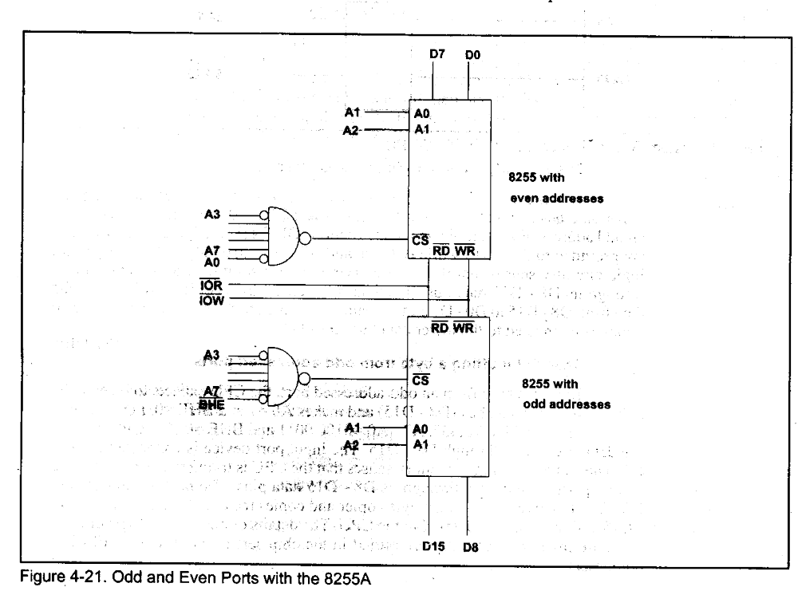
Interfacing 8-bit Peripherals to 16-bit Data Bus
The Problem?
Solutions:
  1) two separate PPI devices.
  Even address for one and odd addresses for other
  OUT port#, AX outputs to both of them!!!
Prof. Virender Kumar Ranga@2009

Slide 54
Interfacing 8-bit Peripherals to 16-bit Data Bus (2)
Solutions:
  2) Hi / Lo byte copier.
  Outputting to odd-addressed ports:
    Hi/Lo byte copier copies data from D8-D15 to D0-D7
  Inputting a byte form odd-addressed ports:
    Hi/Lo byte copier copies data from D0-D7 to D8-D15
  The logic now resides in chipsets.
Prof. Virender Kumar Ranga@2009

Slide 55
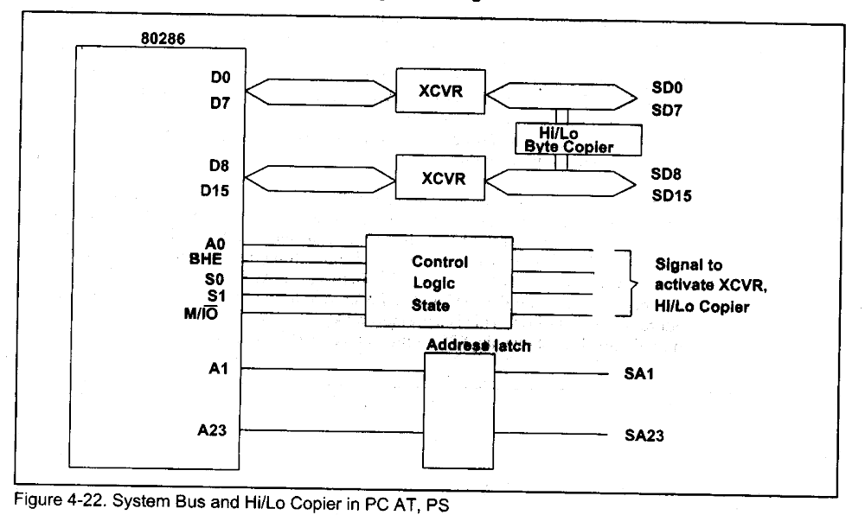
Hi/Lo Copier in PC
Prof. Virender Kumar Ranga@2009

Slide 56
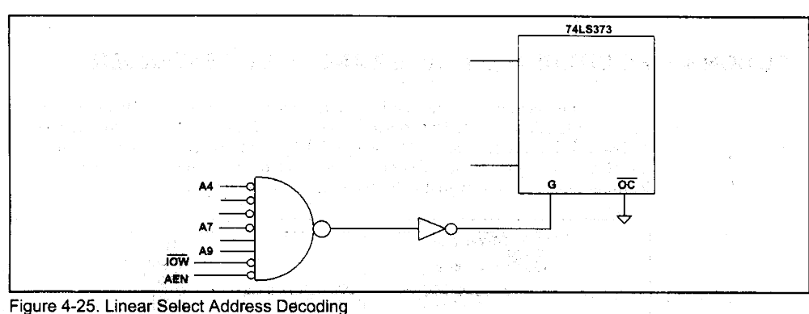
Linear Select Address Decoding
What is the address range and aliases?
Prof. Virender Kumar Ranga@2009

Slide 57
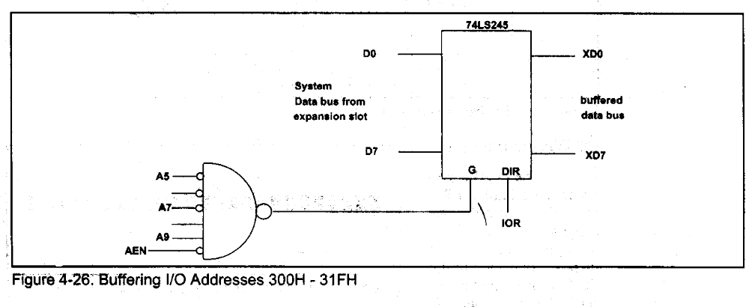
Buffering Selected IO Address Range
Range of addresses?
Blocking others.
Prof. Virender Kumar Ranga@2009

Slide 58
I/O Programming with C and BASIC
Assembly | Microsoft C | Borland C | BASIC
OUT port#, AL | outp (port#, byte) | ouportb(port#, byte) | Out port#, byte
IN AL, port# | var=inp(port#) | var=inportb(port#) | Var = INP (port#)
OUT DX, AX | Outpw(port#, word) | Outport(port#, word) | Out port#, word ??
IN AX, DX | word=inpw(port#) | word=inport(port#) | Var = INP (port#)??
Prof. Virender Kumar Ranga@2009

Slide 59
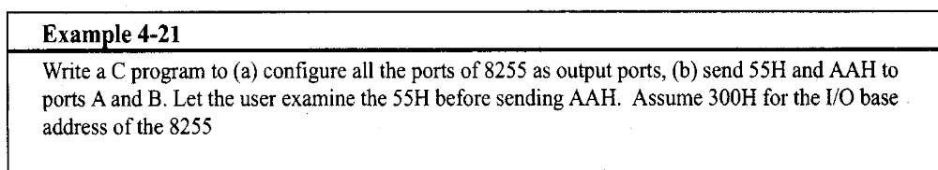
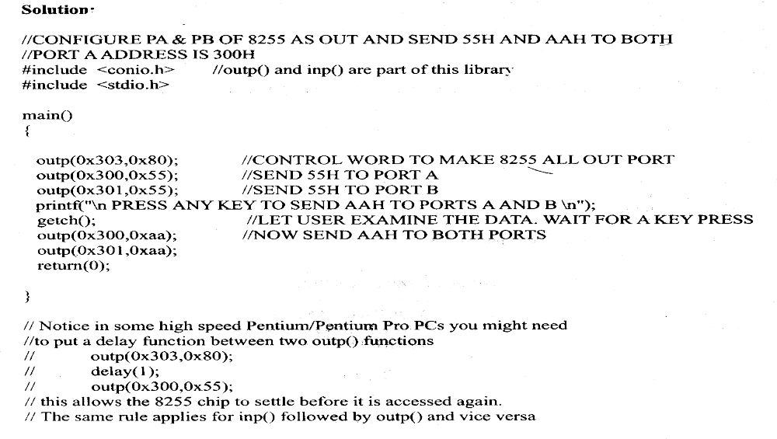
Example
Prof. Virender Kumar Ranga@2009

Slide 60
Example Polling program?
The program makes a “running LED” effect (initially moving from down to up). Every time the lowest button is pressed, it changes the direction of the movement. When the highest button is pressed, the program terminates.
Prof. Virender Kumar Ranga@2009

Slide 61
The Circuit
A19
5V
A18
:
A0
D7
A0
B0
D6
A1
B1
D5
A2
B2
D4
A3
B3
D3
A4
74LS245
B4
8088
D2
A5
B5
D1
A6
B6
Minimum
D0
A7
B7
Mode
E
DIR
D0
Q0
IOR
D1
Q1
D2
Q2
IOW
D3
Q3
D4
Q4
D5
74LS373
Q5
D6
Q6
D7
Q7
A
A
A
A
A
A
A
A
A
A
A
A
A
A
A
A
IOR
LE
OE
1
1
1
1
1
1
9
8
7
6
5
4
3
2
1
0
5
4
3
2
1
0
Prof. Virender Kumar Ranga@2009
A
A
A
A
A
A
A
A
A
A
A
A
A
A
A
A
IOW
1
1
1
1
1
1
9
8
7
6
5
4
3
2
1
0
5
4
3
2
1
0

Slide 62
Trace what the program does:
mov dx, F000
mov ah, 00
mov al, 01
L1: out dx, al
mov cx, FFFF
L2: dec cx
jnz L2
cmp ah, 00
jne L3
rol al, 1
cmp al, 01
jne L1
jmp L4
L3: ror al, 1
cmp al, 80
jne L1
L4: mov bl, al
in al, dx
cmp al, FF
je L6
test al, 01
jnz L5
xor ah, FF
jmp L6
L5: test al, 80
jz L7
L6: mov al, bl
jmp L1
L7:
Prof. Virender Kumar Ranga@2009

Slide 63
What’s the problem with polling in the sample program?
Running LED takes time
User might remove his/her finger from the switch before the in al, dx instruction is executed
the microprocessor will not know that the user has pressed the button
Prof. Virender Kumar Ranga@2009

Slide 64
Problem with Polling
mov dx, F000
mov ah, 00
mov al, 01
L1: out dx, al
mov cx, FFFF
L2: dec cx
jnz L2
cmp ah, 00
jne L3
rol al, 1
cmp al, 01
jne L1
jmp L4
L3: ror al, 1
cmp al, 80
jne L1
L4: mov bl, al
in al, dx
cmp al, FF
je L6
test al, 01
jnz L5
xor ah, FF
jmp L6
L5: test al, 80
jz L7
L6: mov al, bl
jmp L1
L7:
Prof. Virender Kumar Ranga@2009

Slide 65
Interrupt
The microprocessor does not check if data is available.
The peripheral will interrupt the processor when data is available
Prof. Virender Kumar Ranga@2009

Slide 66


Polling vs. Interrupt
instruction
While studying, I’ll check the bucket every 5 minutes to see if it is already full so that I can transfer the content of the bucket to the drum.
Input
Device
Memory
μP
POLLING
Prof. Virender Kumar Ranga@2009
Notes:
We want to fill the drum using the bucket

Slide 67
Polling vs. Interrupt
instruction
I’ll just study. When the speaker starts playing music it means that the bucket is full. I can then transfer the content of the bucket to the drum.
Input
Device
Memory
Interrupt
request
μP
INTERRUPT
Prof. Virender Kumar Ranga@2009

